Slide 1
Intercultural Competence/Citizenship in Language Education
Fourth Annual Workshop for Language Teachers
CLIC, Rice University Houston, Texas
April 27, 2019
Manuela Wagner
manuela.wagner@uconn.edu

Slide 2
1. Intercultural Citizenship in Action: Green Kidz
Collaboration between 5th and 6th grade students in Argentina and 7th grade students in Denmark
➔Some outcomes……

Slide 3
We are going to ask…..
What did you notice in the examples mentioned?
What aspects were related to intercultural competence?
What did the students do?
What do you imagine was the role of the teachers?
What did you like about the project?
Was there anything that worried you?

Slide 4
Outcomes in Argentina
Argentinian students
created videos and songs
shared them in a Facebook group, designed by themselves.
were interviewed by a local journalist and got the collaborative posters published in the local newspaper
printed the posters and distributed them in a kermes (a day when families gather at school to play games and share some time with their pupils, organized annually by the school);

Slide 5
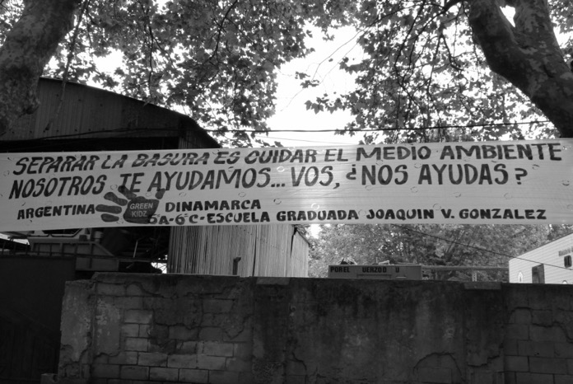
designed a street banner and displayed it in the street in front of the school
Radio Cool, a local radio in La Plata, shared information about the project.

Slide 6
Outcomes in Denmark
The students
put up their posters in the school and distributed them in their community
wrote a letter to the local newspaper Øbro Avis and posted information about the project on the newspapers’ Facebook page
created videos and songs and uploaded them on youtube
informed Greenpeace Denmark and Greenpeace International about the project and posted information about the project in the Danish Green Kidz Facebook group
The video and the posted information represent an invitation to everybody to join the Green Kidz project and to save the environment.

Slide 7
A final youtube video summarized the whole project and included the posters from Denmark and Argentina as well as other project products from both countries such as the surveys and photos

Slide 8
2. What did you notice?
What did you notice in the examples mentioned?
What aspects were related to intercultural competence?
What did the students do?
What do you imagine was the role of the teachers?
What did you like about the project?
Was there anything that worried you?

Slide 9
3. Should we teach intercultural competence in language education, and if so, why?

Slide 10
Plan for today
Why do want/need to teach (languages) for intercultural (communicative) competence/citizenship?
Contexts
Complexity
Challenges
What is a theoretical framework we can use?
What does teaching for intercultural citizenship look like in practice?
Examples
Outcomes
Challenges
What are some ways forward?
Manuela Wagner, 2018

Slide 11
In Globalization 1.0, countries had to think globally to thrive, or at least survive.
In Globalization 2.0, companies had to think globally to thrive, or at least survive.
In Globalization 3.0, individuals have to think globally to thrive, or at least survive.
(Friedman, 2007, p. 278)
Manuela Wagner, 2018
Notes:
It is important to note that Friedman dated Globalization 3.0 to begin around the year 2000.

Slide 12
One thing we all seem to agree on is that, increasingly, we don’t agree on very much. Fundamental and extremely divisive disagreement over religion, morality and science is pervasive in our culture (Lynch and colleagues, p.1).
Lynch and colleagues (n.d.) https://humilityandconviction.uconn.edu/blank/what-is-intellectual-humility/

Slide 13
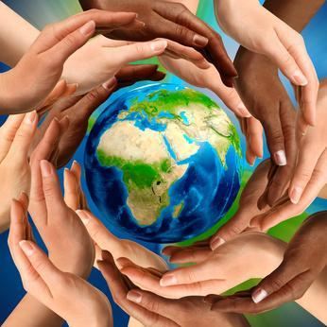
What you can do with others…
Ashdown’s third law is that in the modern age, where everything is connected to everything, the most important thing about what you can do is what you can do with others. (Ashdown, 2012, 15:53)
Manuela Wagner, 2018
Notes:
Veteran Diplomat and Knight Commander of the Order of the British Empire Paddy Ashdown describes the period we live in as
one of those terrifying periods of history when power changes… And these are always periods accompanied by turbulence, and all too often by blood.”

Slide 14
What does that mean?
….......the most important thing about what you can do is what you can do with others
COLLABORATION
ACTION
WITH PEOPLE FROM DIFFERENT BACKGROUNDS
Manuela Wagner, 2018

Slide 15
If today’s students want to compete in this global society, however, they must also be proficient communicators, creators, critical thinkers, and collaborators (the “Four Cs”). Students need to master additional subject areas, including foreign languages, the arts, geography, science, and social studies. Educators must complement all of those subjects with the “Four Cs” to prepare young people for citizenship and the global workforce.
(National Education Association, 2012, p. 5)

Slide 16
Experience of intercultural (democratic) citizenship can take place in many locations and on many occasions, and individuals may reflect and act together with people of other groups accordingly. The role of education is to anticipate and prepare people for such experience and to promote reflection, analysis and appropriate action. Given the tendency of individuals to remain within the security of their own group and to protect their own self-esteem, there is a significant role for education in preparing them to resist this tendency and meet the challenges involved.
(Byram, 2008, p. 187)
Manuela Wagner, 2018

Slide 17
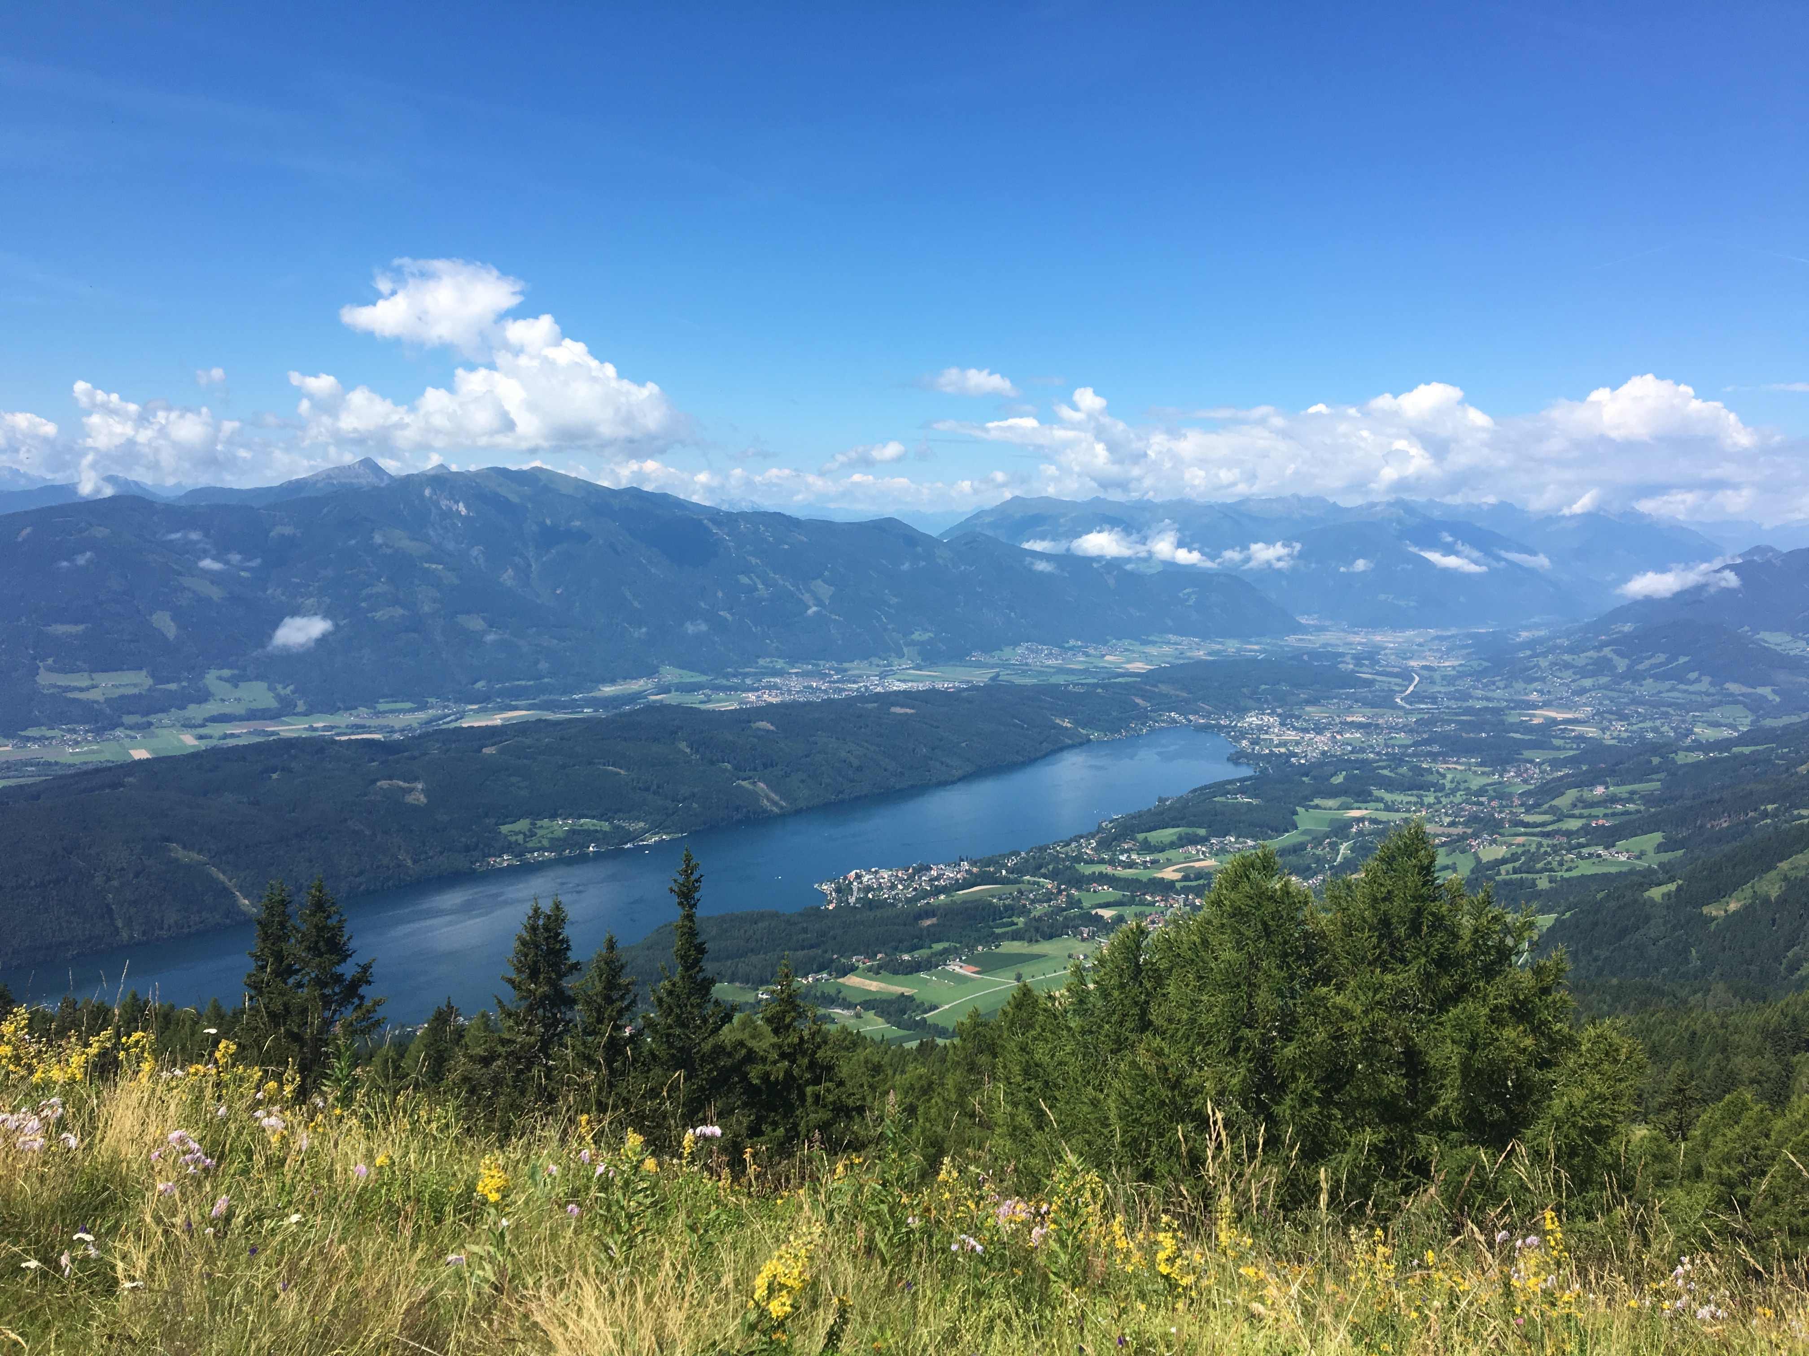
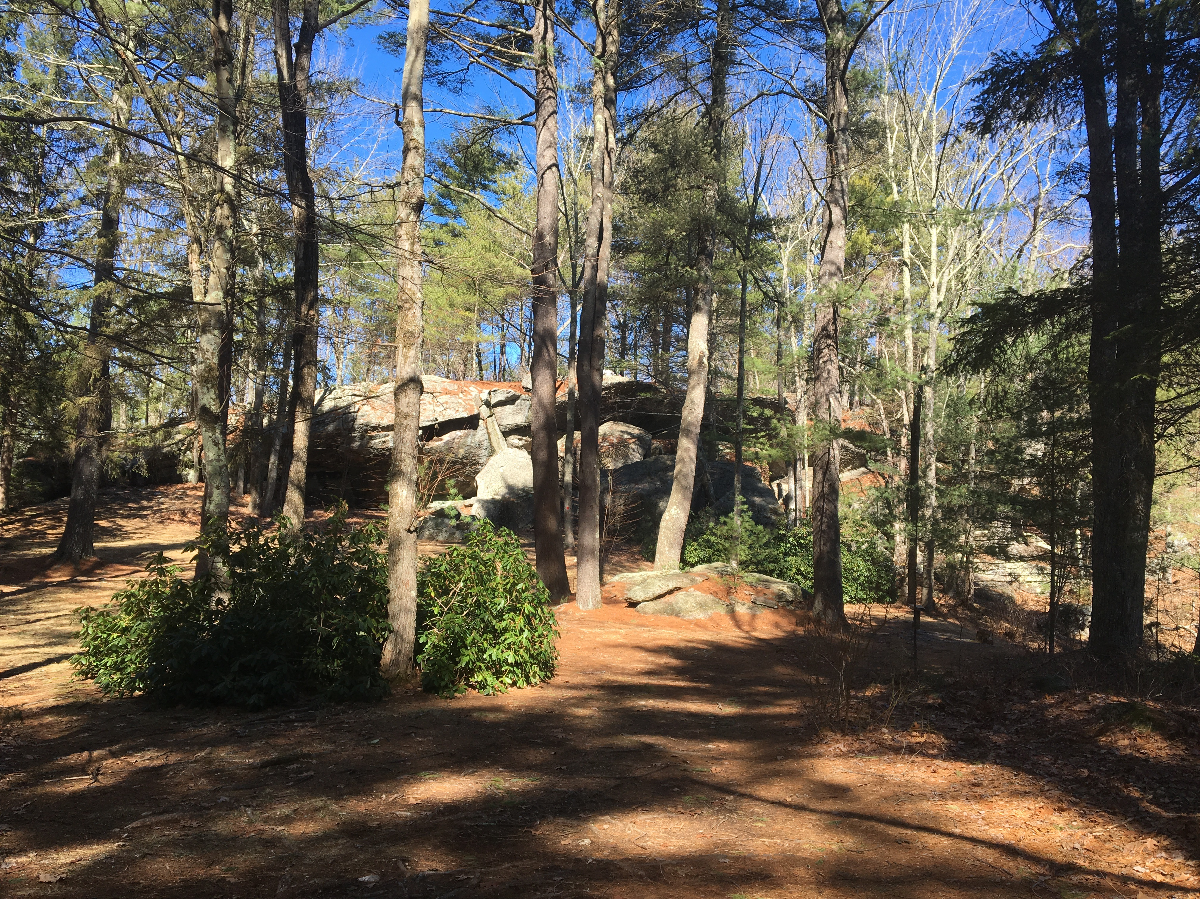
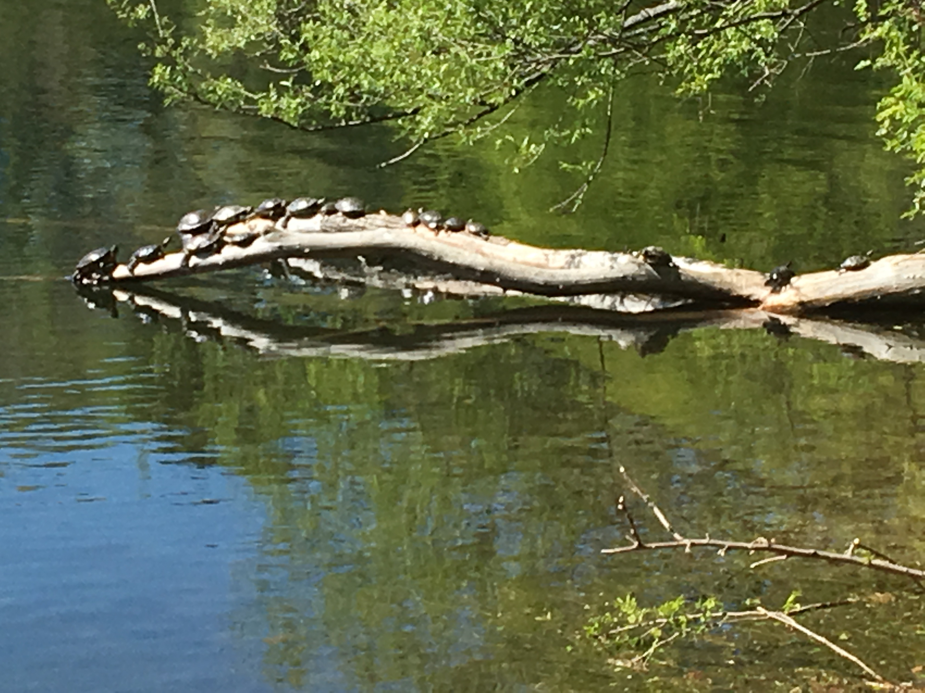
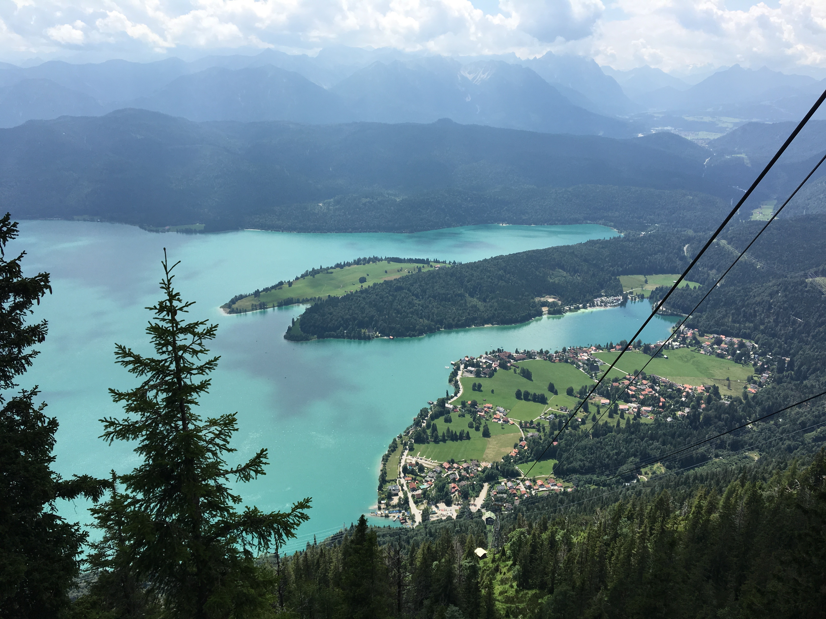
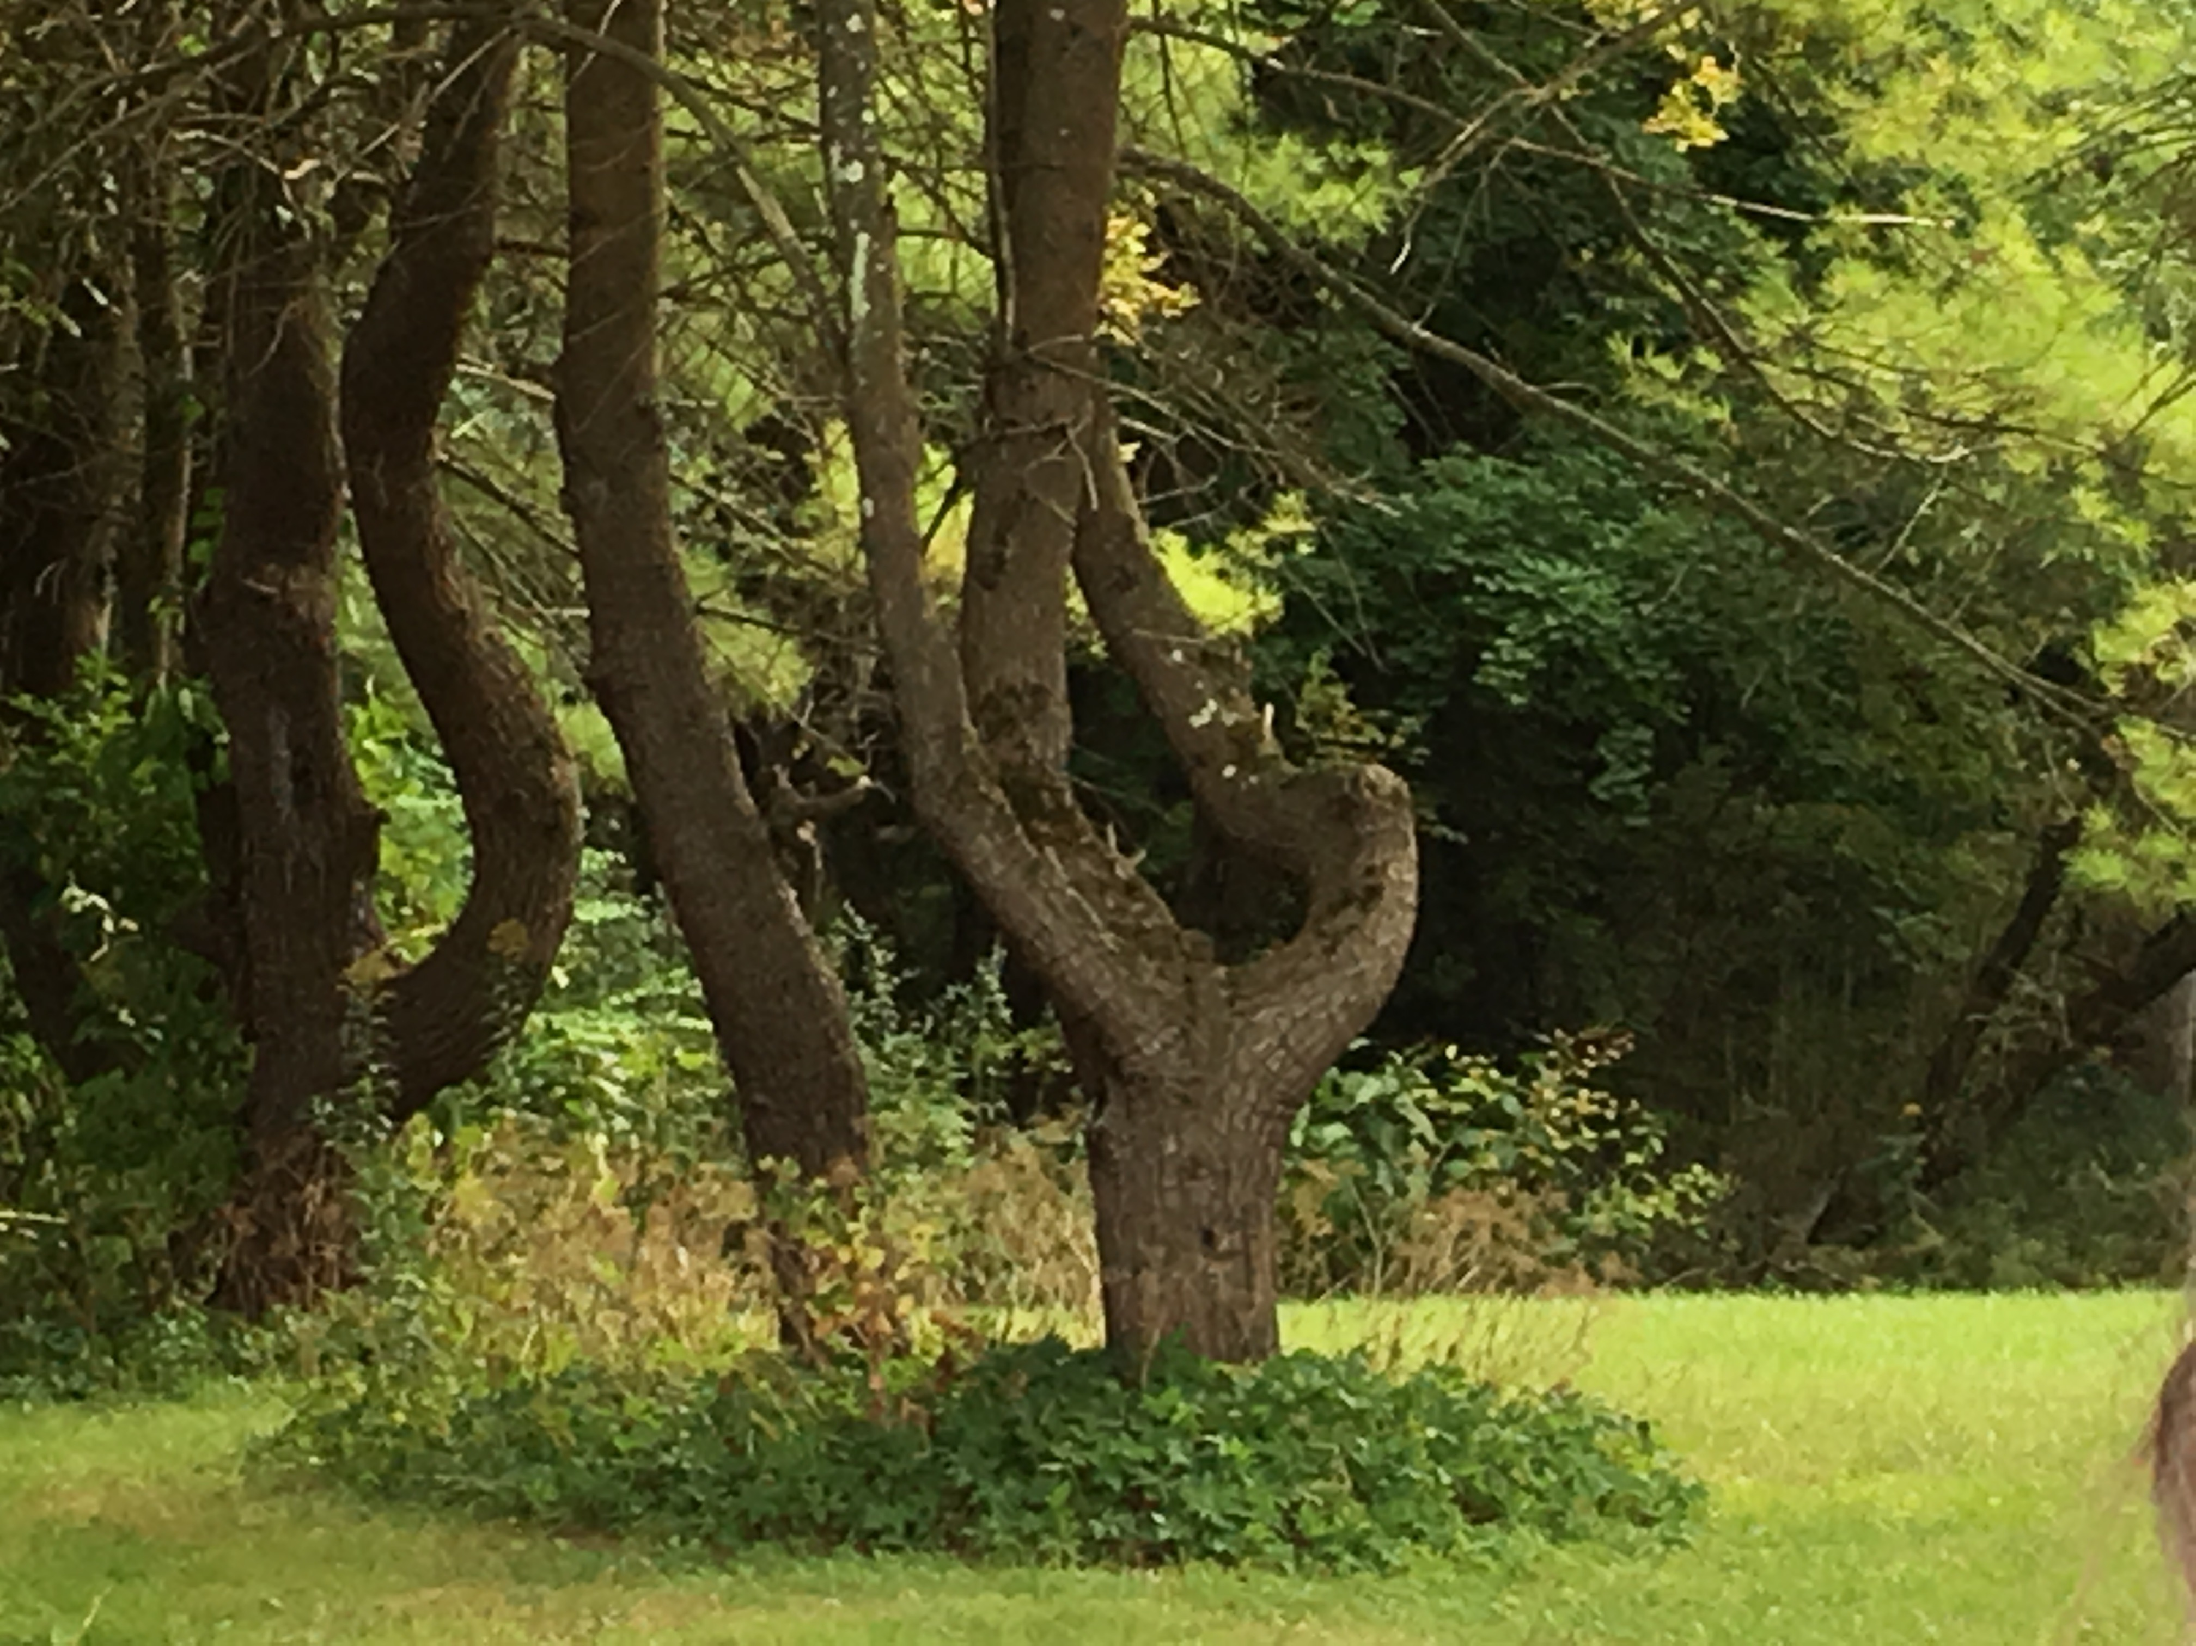
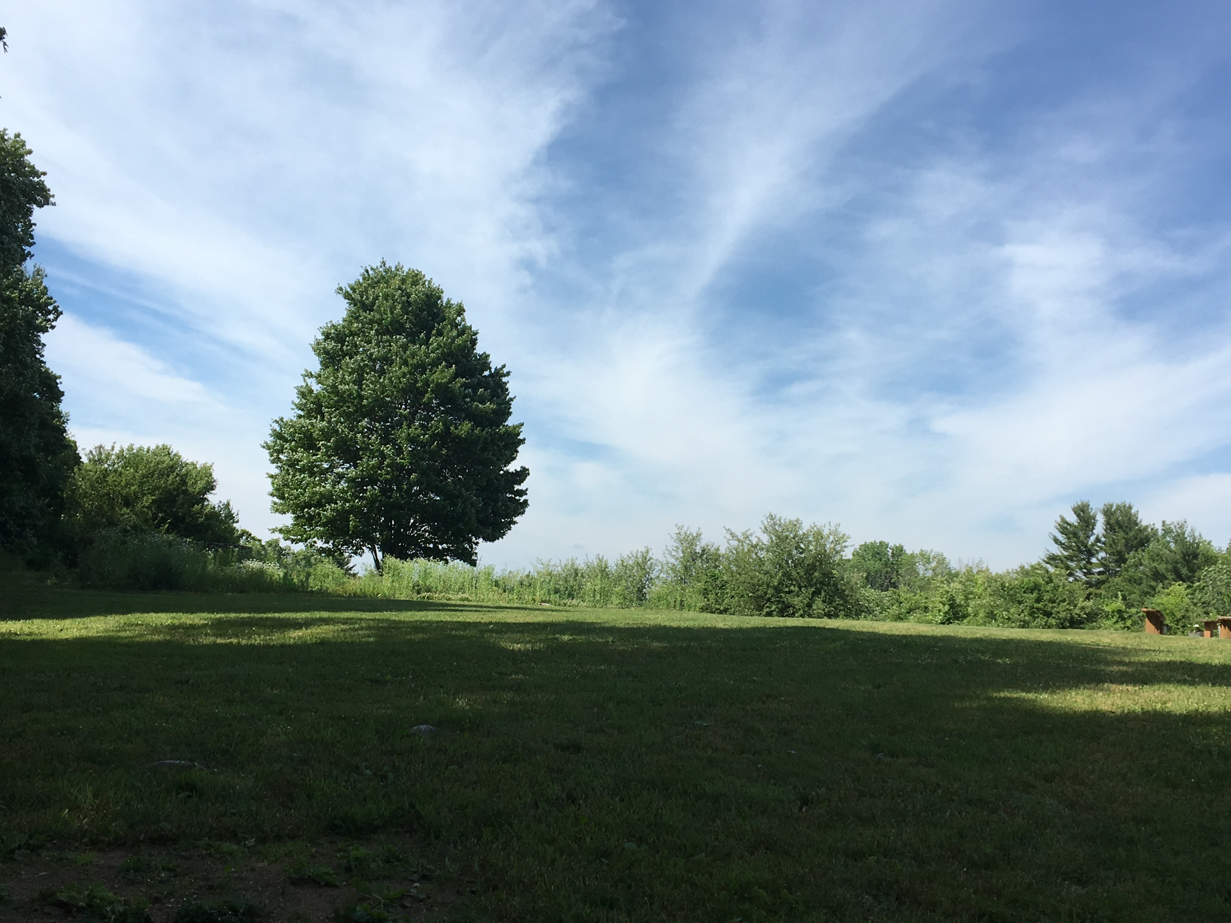

Slide 18
17 Global Goals for Sustainable Development, 193 world leaders
(UN General Assembly, 2015)
Global citizenship has become a prominent goal in education
(e.g., UNESCO, 2015; P21, 2014; COE, 2008; 2016; ACTFL, 2017)

Slide 19
Questions for you...
Do you think language education can be a vehicle to address these problems? How?
Are you already addressing these issues in your teaching?

Slide 20
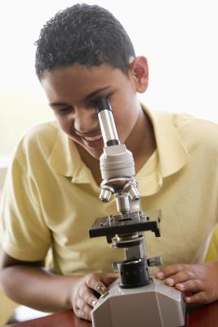
Paradigm Shifts in Teaching and Learning Language
Learning about language
Using language to communicate
Accessing content through language
Credit: Ali Möller

Slide 21
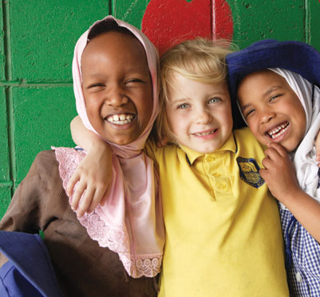
Evolution of National Standards
for Teaching and Learning Culture
Students gain knowledge and understanding
Students interact in culturally appropriate ways
Students use language to build relationships
Credit: Ali Möller

Slide 22
Yet we don’t get our hands too dirty…We don’t usually listen to stories of escaping war and finding refuge and racism in a new land, despite the fact that these events occur in settings where so many of the languages taught in classrooms around the world are spoken.
(Ennser-Kananen, 2016, p.557)
Manuela Wagner, 2019

Slide 23
Plan for today
Why do want/need to teach (languages) for intercultural (communicative) competence/citizenship?
Contexts
Complexity
Challenges
What is a theoretical framework we can use?
What does teaching for intercultural citizenship look like in practice?
Examples
Outcomes
Challenges
What are some ways forward?
Manuela Wagner, 2018

Slide 24
What is culture?

Slide 25
Think- Pair- Share
How would you define “culture”?
What does “intercultural competence” mean for you?
Why and how is ICC important in the classroom?
2 min
Co-constructed definitions of
“culture”:
“intercultural communicative competence”:
5 min

Slide 26
How did you define culture?

Slide 27
What is intercultural communicative competence (ICC) in your opinion?
Is ICC important in language teaching?

Slide 28
culture as…......
an open, penetrable, diffuse, contradictory and fluid construct
interwoven, discursively produced
dependent on hierarchical power structures
encompasses factors such as gender, educational level, generation, religion and status (adapted from Hiller, 2010, p.148)
Liquid understanding of culture (Dervin, 2006)
Manuela Wagner, 2018

Slide 29
What are the similarities between our definitions and Hiller’s definition?
Is there anything we did not mention?
What do you like/dislike about the definition?
What does that mean for you in terms of teaching culture and ICC?

Slide 30
Culture and Language
Many definitions of culture; ‘culture’ itself problematic.
Myth: Language and culture are inextricably linked.
Myth: When we teach a language we automatically teach intercultural competence.
My pet peeve: We do not need languages when we teach intercultural competence.
Manuela Wagner, 2018

Slide 31
Culture and Language
Many definitions of culture. Dynamic nature of culture.
Myth: Language and culture are inextricably linked.
Myth: When we teach a language we automatically teach intercultural competence.
My pet peeve: We do not need languages when we teach intercultural competence.
Manuela Wagner, 2018
Notes:
Karen Risager and Claire Kramsch write about the culture and language nexus. Mike Byram and I mentioned it in an article in which we talked about the next 50 years of teaching intercultural communication as well.
The book presents a new theory of the relationship between language and culture in a transnational and global perspective. The fundamental view is that languages spread across cultures, and cultures spread across languages, or in other words, that linguistic and cultural practices flow through social networks in the world along partially different paths and across national structures and communities.
For now it suffices to say that language and culture are not inextricably linked and that we do not automatically teaching intercultural competence when we teach language. We now know that we need to be systematic about it. More about this later.

Slide 32
Language and Culture: Sociological point of view
Language and culture can be separated in three ways:
- learners of language X import into it the meanings and connotations from their existing languages, whether first language or others;
- discourse about a topic spreads from language to language even though translation processes may affect it;
- as people migrate, they carry their discourse and ways of thinking – and the connotations of what they say – into new contexts and languages (pp. 194ff);
and, we would add, languages are adopted and modified by societies as their ‘national’ or ‘official’ language and acquire new meanings, forms and connotations.
(Risager, 2006)

Slide 33
Germany is Europe’s most important country of our day. Teach its history, revel in its culture, analyse the strength of its economy. Visit its cities and countryside – and see how much better they are planned and protected than ours. In comparison, learning Germany’s language is not that important. (¶ 7)
The Guardian, Simon Jenkins (2017)
Manuela Wagner, 2018
Notes:
In the British newspaper The Guardian, Simon Jenkins (2017), argues that language learning is not necessary, and that there are always other ways to understand other countries. He takes the example of Germany to make this point:

Slide 34
Even where in Europe the lingua franca of (academic) papers is English, I can promise you that the language of the bar isn’t (or the toilets, for that matter). You get left out of an awful lot of what is really going on if you can only communicate in English. (¶ 6)
Mary Beard (2017)
Manuela Wagner, 2018
Notes:
Jenkins’ view is refuted by a well-known academic,

Slide 35
Plan for today
Why do want/need to teach (languages) for intercultural (communicative) competence/citizenship?
Contexts
Complexity
Challenges
What is a theoretical framework we can use?
What does teaching for intercultural citizenship look like in practice?
Examples
Outcomes
Challenges
What are some ways forward?
Manuela Wagner, 2018
Notes:
There are a number of frameworks and organizations such as the CoE and ACTFL are also working on developing more comprehensive models to be used in education. I am going to focus on the model of intercultural citizenship by Michael Byram today.

Slide 36
Intercultural Communicative Competence
INTERCULTURAL COMMUNICATIVE
COMPETENCE
linguistic competence
sociolinguistic competence
discourse competence
INTERCULTURAL COMPETENCE
skills of interpreting/
relating
critical
cultural
awareness
attitudes of
curiosity/
openness
knowledge
skills of discovery/
interaction
(Byram, 1997)
Manuela Wagner, 2018
Notes:
THREE DOMAINS
• propositions, ideas and theories – i.e. what learners learn about the world (in formal education what they learn in their ‘subjects’);
• the internal world, that is oneself, a form of critical thought that is demonstrated in critical self-reflection – i.e. what learners think about themselves as individuals;
• the external world, a form of critical thought that is demonstrated in critical action – i.e. what learners do as a result of their thinking and learning.
He also identifies four levels or degrees of criticality – increasingly complex/deep:
FOUR LEVELS:
• critical skills – reflexivity – refashioning of traditions – transformatory critique.
At the first level the emphasis is on skills of learning how to be critical (and ‘critical’ of course does not mean ‘being negative or attacking something/somebody – it means evaluating positive and negative).
At the second level the skills are applied to the knowledge learners have acquired, to their own selves and to the world.
At the third level, the criticality leads to change in the sense of modification of what has so far been accepted as ‘common sense’ in knowledge, in oneself, in what we do in the world.
At the fourth level, the change is more radical and change is not just modification of what is ‘common sense’ or ‘taken for granted’ but is in fact overturning this and developing something new.

Slide 37
Intercultural Citizenship (Byram, 2008)
INTERCULTURAL COMMUNICATIVE
COMPETENCE
preparing students to act in a multicultural and international community with more than one set of cultural values, beliefs, and behaviors
adding the acquisition and implementation of skills of “active citizenship” or “political and civic engagement” (Barrett and Zani, 2015)
linguistic competence
sociolinguistic competence
discourse competence
INTERCULTURAL COMPETENCE
skills of interpreting/
relating
critical
cultural
awareness
attitudes of
curiosity/
openness
knowledge
skills of discovery/
interaction
Byram, 1997
Manuela Wagner, 2018
Notes:
Citizenship objectives also in FLE:
Critically analysing problems in learners’ community/society
Preparing for communicating in community/society
FLE objectives more than in Cit Ed:
Community/society in question is international and/or multicultural and multilingual
BUT - in Cit Ed and not in FLE:
→→ engaging in social action – in the multilingual/multicultural community/society within and beyond national frontiers

Slide 38
Intercultural Citizenship (Byram, 2008)
“Drawing on political education theory and on proposals for education for democracy”(P.185)
“Introducing a curriculum that responds to the demands of globalisation/internationalisation” (p.185)
Combining intercultural competence with “internationalism” and “acting in the here and now”
“Change in relationship with Others” (p.207)

Slide 39
University Elementary German, online
IC Online: Fostering the Development of Intercultural Competence in Virtual Language Classrooms, University Elementary German
(Manuela Wagner and Niko Tracksdorf)

Slide 40
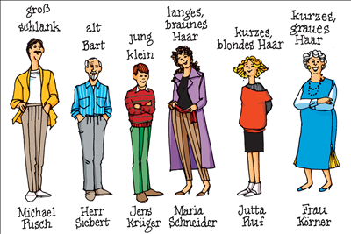
Aussehen (Appearance)
Wer ist ?
blond
groß
klein
schlank
jung
alt
Wer hat ?
braunes Haar
graues Haar
kurzes Haar
langes Haar
einen Bart
blaue Augen
braune Augen

Slide 41
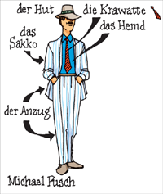
Kleidung (Clothes)
Wer im Deutschkurs trägt ?
eine Bluse einen Rock
eine Jacke ein Kleid
Stiefel ein Hemd
eine Hose einen Hut
Sportschuhe einen Pullover
eine Krawatte einen Anzug
Notes:
Description of people: only “the person” no gender identifiers (such as he or she)

Slide 42
Beschreibe die Person: Describe this person
Heidi Klum
Supermodel
German and US citizenships (according to Wikipedia)

Slide 43
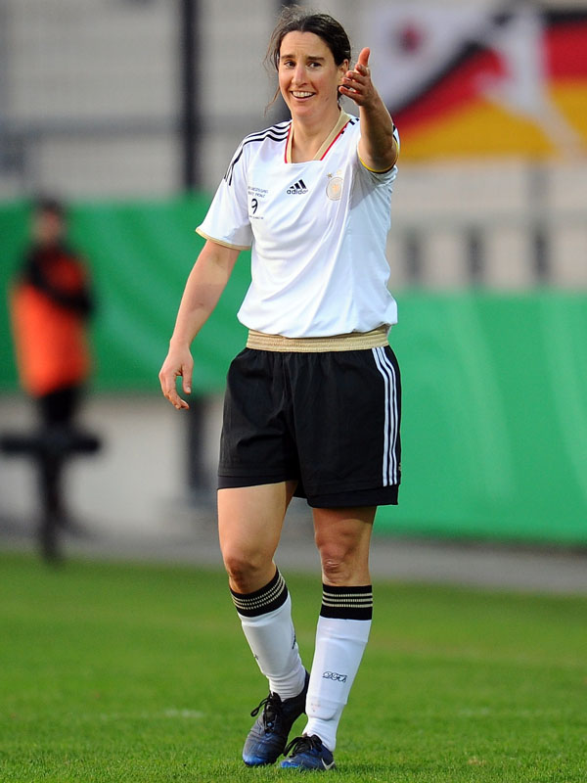
Beschreibe die Person:
Birgit Prinz
Former German soccer player
Germany

Slide 44
Beschreibe die Person:
Sara Nuru
German fashion model

Slide 45
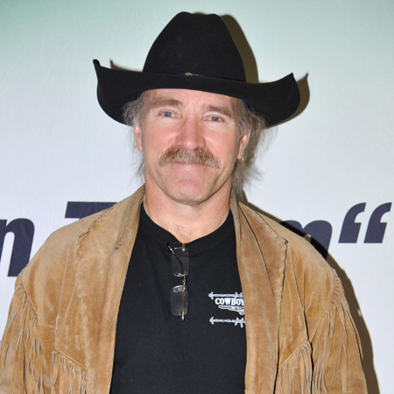
Beschreibe die Person:
Konny Reinmann
Born in Hamburg, Germany
Moved to USA in 2004

Slide 46
Beschreibe die Person:
Conchita Wurst (Thomas „Tom“ Neuwirth)
Austrian
Singer and self-proclaimed drag queen
Won European Song Contest 2014

Slide 47
EXAMPLE:
The role of sports in Germany versus the USA
Lincoln-Sudbury Regional HS
Partner School visit (Vilshofen, Bavaria, Germany)
Topics:
Sports and Leisure (German)
Wellness (Wellness program)
Notes:
Why we need to do something?
Show the example

Slide 48
Intercultural Citizenship:
KNOWLEDGE
DISCOVERY
INTERPRETING and RELATING
1) American students read information about sports in Germany.
German students read information about sports in America.
2) Homework Reflection:
Does anything strike you as odd/weird?
Which are the three things you found most
interesting/surprising?
Which of these interesting facts are specific to the culture (American or German)?
Can you identify one or two things that you would not find in your own country?
Prepare 2-3 questions in German that you will ask your German classmates to get more information about this.

Slide 49
Intercultural Citizenship:
Discovery/ Interaction
&
Interpreting/
Relating
3) Students ask each other their prepared questions (treating the others as experts) 4)complete/make a table with their own beliefs (hetero stereotype/auto stereotype)
About USA | about Germany
Americans are the best at all sports | Soccer is not a real sport/is boring
Baseball is boring | Germans are not good at baseball
Rock climbing is for boys | Rock climbing is for boys
There is no racial discrimination in sports | There is no racial discrimination in sports
Notes:
German students bring back their new found understanding and share/discuss with their classmates in Germany deconstructing their visit to USA and vice versa. This can be the basis of a critical discussion: e.g., If we found there is discrimination in sports “in the other country” does that happen here as well?

Slide 50
Intercultural Citizenship:
CRITICAL CULTURAL AWARENESS - ANALYSING AND CONCLUDING ABOUT ‘THE OTHER’
FAKTENDETEKTIVE
Confirm or disconfirm the statements on your tables by interviewing your German classmates. You need to make a conclusion based on your interviews (at least 5 students), and “facts” you read. Represent your information/data in a way that your conclusions can be understood from these representations.
Fakt 1: In Deutschland... | wahr | falsch | Meine Meinung?
Interview 1:
Interview 2:
Interview 3:
Notes:
German students bring back their new found understanding and share/discuss with their classmates in Germany deconstructing their visit to USA and vice versa. This can be the basis of a critical discussion: e.g., If we found there is discrimination in sports “in the other country” does that happen here as well?

Slide 51
Intercultural Citizenship:
ACTION IN THE COMMUNITY
Students share what they learned during this activity with a group of students in their context that has not been part of this activity.
Posters/webpages/brochures
the German group will present in Germany
In America: presentation to wider school community
[invite students/community - with food!]
Notes:
German students bring back their new found understanding and share/discuss with their classmates in Germany deconstructing their visit to USA and vice versa. This can be the basis of a critical discussion: e.g., If we found there is discrimination in sports “in the other country” does that happen here as well?

Slide 52
Interdisciplinary Intercultural Citizenship
Natural Disasters: Hurricane Maria
Essential Question:
What are the relationships between interdisciplinary knowledge of natural disasters and the quality of life in our interconnected contemporary world?

Slide 53
Interdisciplinary Intercultural Citizenship Goals
Learners will: - interpret and relate information about Hurricane Maria in specific regions in Puerto Rico to similar disasters in contemporary history - discover and interact with others in the TL in order to gain new knowledge and perspectives on the issue at hand - make judgements about how to deal with natural disasters based on specific evidence and different (cultural) perspectives (and understanding of their relationship with cultural products and practices) - present pertinent information to an outside audience and thereby contribute to solving a problem in a local, national, or international community (action component) Learners will acquire knowledge about: - Hurricane Maria as an event of major societal as well as natural significance how people respond to natural disasters and how responses vary in different cultural contexts - how disasters are presented in the media and how this varies across contexts

Slide 54
Intercultural Citizenship Connections with other Disciplines
Mathematics Analyze and interpret information using quantitative reasoning (reasoning that requires the use of mathematics in authentic situations, including socio-political, where estimation and knowledge from other disciplines might be crucial) to understand the phenomenon and support claims Use relative thinking to compare across data Create viable mathematical arguments drawn from evidence Use mathematical representations in meaningful ways to support arguments Interpret and/or apply statistical data and representations in meaningful ways to support arguments

Slide 55
Summative Performance Tasks: Interpretive Mode
Read news articles on Hurricane Maria Demonstrate understanding by completing a graphic organizer (See above list of Resources for suggestions) | Watch videos on Hurricane Maria Demonstrate understanding by synthesizing the information with the main points raised in the video(See above list of Resources for suggestions) | Analyze statistics on Hurricane Maria Demonstrate understanding by identifying the findings and evidence to incorporate in their presentation(See above list of Resources for suggestions)

Slide 56
Summative Performance Tasks: Presentational Mode
Work in groups to design multimedia presentation on the effects of Hurricane Maria on PR and the region
On demand: Present individual findings to be included in presentations to the group (scaffolded through guided questions)
Polished: Prepared and practiced presentation of results in town hall meeting

Slide 57
Interpersonal Mode Teacher moderates a meeting (of different classes or within the same class) in which students discuss what they have learned about Hurricane Maria as well as possible action projects based on their findings on the effects of Hurricane Maria (leading up to this assessment we suggest the inclusion of an interpersonal assessment such as the following: Students in groups of 3 discuss their key findings and how they want to present they recommendation to the whole group in the “town hall” meeting format

Slide 58
Can Do Statements
Interpretive | I can demonstrate my understanding of the impact of Hurricane Maria on different areas of concern for Puerto Rico, other countries, the U. S., and my own community. I can interpret information about the different ways in which Hurricane Maria has impacted other countries, the U. S., and my own community. I can analyze different sources of information to better understand the effects of Hurricane Maria.
Presentational | I can describe experiences and events related to f Hurricane Maria using a range of conduits: visual and/or oral presentations; I can make others aware of the impact of Hurricane Maria on PR and my community; I can express and support recommendations for disaster preparations and recovery efforts in my and in my partners’ community
Interpersonal | I can ask and answer questions about natural disasters. I can discuss action items to address effects of Hurricane Maria.

Slide 59
Explanations and Examples
Wagner, M., & Byram, M. (2016). Developing Intercultural Communicative Competence in the World Language Classroom: Part 1” CASLS Topic of the Week: 2016-05-30, Center for Applied Second Language Studies Eugene, OR: University of Oregon. Center for Applied Second Language Studies. http://caslsintercom.uoregon.edu/content/21228
Wagner, M., & Byram, M., & Cardetti, F. (2016). Developing Intercultural Communicative Competence in the World Language Classroom and Beyond: Part 2”. CASLS Topic of the Week: 2016-06-20, Center for Applied Second Language Studies Eugene, OR: University of Oregon. Center for Applied Second Language Studies http://caslsintercom.uoregon.edu/content/21294
Bohling, A., Wagner, M., Cardetti, F., & Byram, M. (2016). Unit: Understanding Different Scenarios in Immigration” CASLS Topic of the Week: 2016-06-20, Center for Applied Second Language Studies Eugene, OR: University of Oregon. Center for Applied Second Language Studies http://caslsintercom.uoregon.edu/content/21365

Slide 60
Outcomes/Reflections
DESIRABILITY OF SUCH PROJECTS
Learners can develop intercultural citizenship and criticality (or make big strides towards it) in our classrooms
Social justice issues
important aspect of ICit Ed
help learners take a critical look at complex topics
motivate learners to take action
Most projects successfully combined development of language and ICit and criticality
Variety of educational technology and social media facilitated different projects
Manuela Wagner, 2018

Slide 61
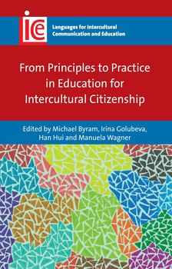
Porto, Daryai-Hansen, Arcuri, Schifler, 2018: Green Kidz: Young learners engage in intercultural environmental citizenship in English language classroom in Argentina and Denmark.
In: Byram, M., Golubeva, I., Han, H., & Wagner, M. (Eds.). (2017). Education for Intercultural Citizenship: Principles in Practice. Clevedon, UK: Multilingual Matters.

Slide 62
Wagner, M., Cardetti, F., & Byram, M. (in press). Teaching Intercultural Citizenship Across the Curriculum: The Role of Language Education. Alexandria, VA: American Council on the Teaching of Foreign Languages.
Intercultural citizenship across the curriculum
Mathematics, social studies, science, art, etc.
From elementary school to higher education
The Role of Language Education
Water Crisis
Hurricane Maria
Immigration
Refugee Peace project
Manuela Wagner, 2019

Slide 63
Additional projects
Manuela Wagner, 2018

Slide 64
APPLYING ICC/ICIT IN YOUR CONTEXT
Options:
A) Modifying a unit
B) Design a plan for how you want to integrate Intercultural Communicative Competence or Intercultural Citizenship
C) Preparing an advocacy statement of why one would want to integrate Intercultural Communicative Competence/Intercultural Citizenship in a program

Slide 65
In your groups, please look at the components of Intercultural Citizenship and discuss how you understand each component (either in the form of a short definition, an example, or a question)
 | My understanding/an example
Knowledge
Skills of Interpreting and Relating
Skills of Discovery and Interaction
Attitudes
Critical Cultural Awareness
Action in the local/national/international community
Concern about Social Justice/Human Rights
Intellectual Humility

Slide 66
YOUR TURN
In your group, think about an activity/a unit in which you are currently teaching aspects of culture and ICC. Applying what we have just discussed, try to include ICC using a framework of your choice. How can you modify what you are currently doing to teach ICC in the target language? Which aspects of ICC are you planning to address?

Slide 67
Your activities/units

Slide 68
What are some tools for using the TL when we integrate ICC in the language classroom?
Group work:

Slide 69
Challenges
Time
Timing
Logistics
Language proficiency
Different expectations
Dealing with highly sensitive political issues
Manuela Wagner, 2018

Slide 70
Ways of moving forward
Intentionality in ICit education
Community of practice is important
Commitment to apply theory in practice
Can be applied to different contexts (e.g., local communities, different subjects, etc.)
Teacher education and/or professional development crucial
Perseverance
Language educators as advocates for all language learners
Manuela Wagner, 2018

Slide 71
….. in the modern age, where everything is connected to everything, the most important thing about what you can do as (language) educators is to show our students how they can continue to learn how to do things with others.
….. (language) teaching professionals accept our social and political responsibilities and change our professional identity to help prepare our students to live and thrive in multilingual and multicultural societies, including our own.
(Byram & Wagner, 2018)
Manuela Wagner, 2018
Notes:
Veteran Diplomat and Knight Commander of the Order of the British Empire Paddy Ashdown describes the period we live in as
one of those terrifying periods of history when power changes… And these are always periods accompanied by turbulence, and all too often by blood.”

Slide 72
References
Ashdown, P. Global Interconnection Between People And Nations – A Fact Of Life.
https://www.youtube.com/watch?time_continue=960&v=zuAj2F54bdo
Barnett, R. 1997, Higher Education: A critical business. London: Open University Press .
Beard, M. (2017, Aug. 27). Why learn German? Times Literary Supplement. Retrieved from https://www.the-tls.co.uk/why-learn-german/
Barrett, M., & Zani, B. (2015). Political and civic engagement: Theoretical understandings, evidence and policies. In M. Barrett and B. Zani (Eds.), Political and civic engagement: Multidisciplinary perspectives (pp. 3-25). London: Routledge.
Byram, M. (1997) Teaching and assessing intercultural communicative competence. Clevedon, UK: Multilingual Matters.
Byram, M. (2008) From foreign language education to education for intercultural citizenship. Clevedon, UK: Multilingual Matters.
Byram, M., Golubeva, I., Han, H., & Wagner, M. (Eds.) (2016). From principles to practice in education for intercultural citizenship Education for Intercultural Citizenship – Principles in Practice. Bristol: Multilingual Matters.
Byram M, Wagner M. Making a difference: Language teaching for intercultural and international dialogue. Foreign Language Annals. 2018;51:140–151. https://doi.org/10.1111/flan.12319
Dervin, F. 2006. Reflections on the deconditioning of language specialists in Finnish Higher Education. In Dervin, F. & E. Suomela-Salmi. Intercultural communication and education. Finnish perspectives. Bern: Peter Lang.
Friedman, T. (2007). The world is flat 3.0. A World History.Hiller, G.G. (2010). INNOVATIVE METHODS FOR PROMOTING AND ASSESSING INTERCULTURAL COMPETENCE IN HIGHER EDUCATION. Proceedings of Intercultural Competence Conference, August, 2010, Vol. 1, pp. 144-168 http://cercll.arizona.edu/ICConference2/malgesini.pdf
Jenkins, S. (2017, Aug. 25) Ignore the panic. There is little point in learning languages in school. The Guardian. Retrieved from https://www.theguardian.com/commentisfree/2017/aug/25/languages-exams-test-league-tables-schools-fall-pupils
Porto, M., & Yulita, L. (2017). Intercultural citizenship education for a culture of peace: The Malvinas/Falklands project. In M. Byram, I. Golubeva, Han H., & M. Wagner (Eds.), From principles to practice in education for intercultural citizenship (pp. 199-224). Bristol: Multilingual Matters.
Sorrells, K. 2015. Intercultural communication. Globalization and social justice (2nd edition). London: Sage Publications.
Wagner, M , Perugini, D., & Byram, M (Eds.) (2017). Teaching intercultural intercultural competence across the age range– From Theory to Practice. Bristol: Multilingual Matters.
Pictures
World Puzzle: http://maxpixel.freegreatpicture.com/Globalization-Global-Earth-World-Continents-Puzzle-2718829
World in Hands: http://maxpixel.freegreatpicture.com/Map-Global-Globe-World-Earth-Hands-Creative-Blue-600497
Manuela Wagner, 2018

